Slide 1
Terraform for Azure

Slide 3
Terraform to Azure Module 04 - Terraform Module
Notes:
https://developer.hashicorp.com/terraform/tutorials/modules/module

Slide 4
Overview
After completing this learning unit, you will understand
Modules overview
What is a Terraform module?
First Terraform module

Slide 5
Modules overview

Slide 6
Modules overview
As you manage your infrastructure with Terraform, you will create increasingly complex configurations.
There is no intrinsic limit to the complexity of a single Terraform configuration file or directory, so it is possible to continue writing and updating your configuration files in a single directory.
However, if you do, you may encounter one or more problems:

Slide 7
Problems
Understanding and navigating the configuration files will become increasingly difficult.
Updating the configuration will become more risky.
There will be an increasing amount of duplication of similar blocks of configuration, for instance when configuring separate dev/staging/production environments.

Slide 8
Problems
You may wish to share parts of your configuration between projects and teams and will quickly find that cutting and pasting blocks of configuration between projects is error prone and hard to maintain.
Engineers will need more Terraform expertise to understand and modify your configuration. This makes self-service workflows for other teams more difficult, slowing.

Slide 9
What is a Terraform module?

Slide 10
What is a Terraform module?
A Terraform module is a set of Terraform configuration files in a single directory.
Even a simple configuration consisting of a single directory with one or more .tf files is a module.

Slide 11
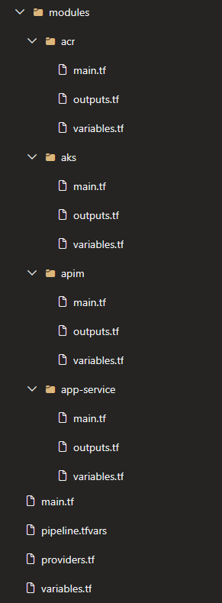
The structure of a Terraform module

Slide 12
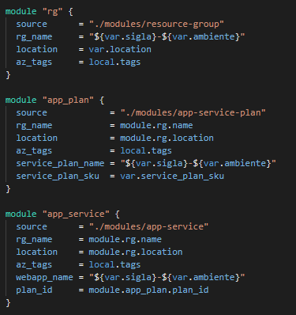
Reference a Module
Edit the main.tf in your root folder and add a reference to module

Slide 13
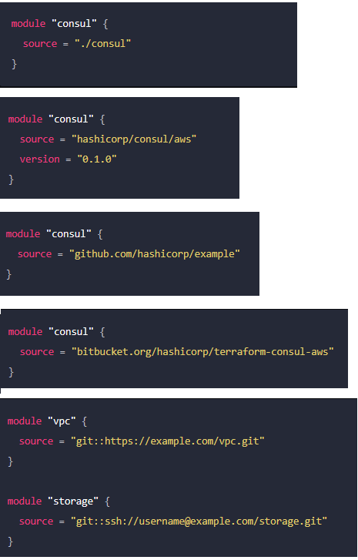
Module Source
Local paths
Terraform Registry
GitHub
Bitbucket
Generic Git, Mercurial repositories
HTTP URLs
Notes:
https://developer.hashicorp.com/terraform/language/modules/sources

Slide 14
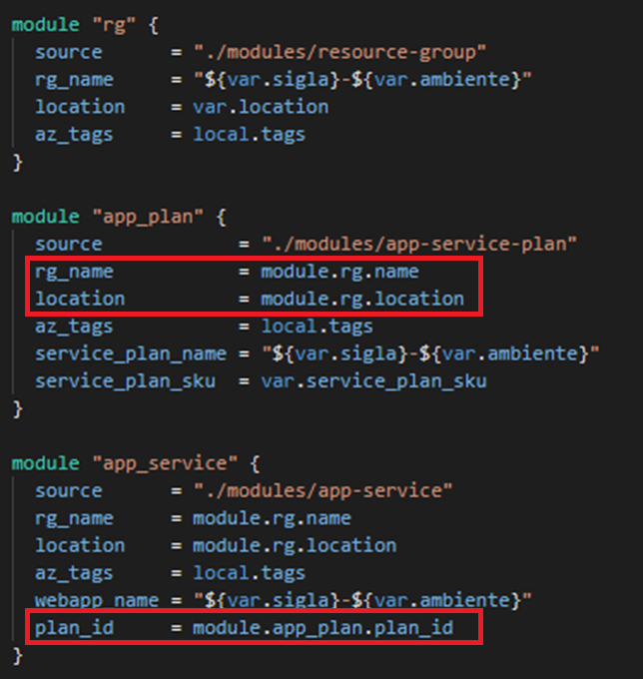
Reference Output
You can access module output variables using the following syntax: module.<MODULE_NAME>.<OUTPUT_NAME>

Slide 15
First Terraform Module
Notes:
Browse Providers | Terraform Registry

Slide 16
First Module
Create Module Folder
Create Resource Group folder
Create Service Plan folder
Create App Service folder
Create main.tf

Slide 17
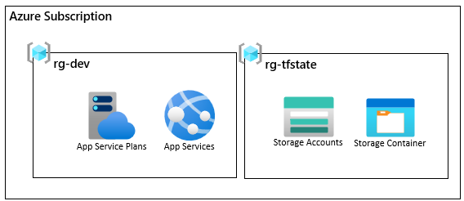
DEMO
Notes:
Folder: Demos/Exemplo05-Modules
In this example, it should be explained how to work with Terraform in modules.
Terraform modules are a way to organize the code to create resources in Terraform. Modules allow you to group resources together and reuse them in different parts of your code.
To use Terraform modules, you need to create a module with the resources you want to create and call that module in your main Terraform file.
Inside the `modules` folder are the modules that contain the definition of the resources to be created.
The `main.tf` file contains the definition of the resources to be created and calls the modules that are in the `modules` folder.

Slide 18
Multiple Environments
Notes:
https://blog.gruntwork.io/how-to-create-reusable-infrastructure-with-terraform-modules-25526d65f73d
https://developer.hashicorp.com/terraform/language/settings/backends/configuration

Slide 19
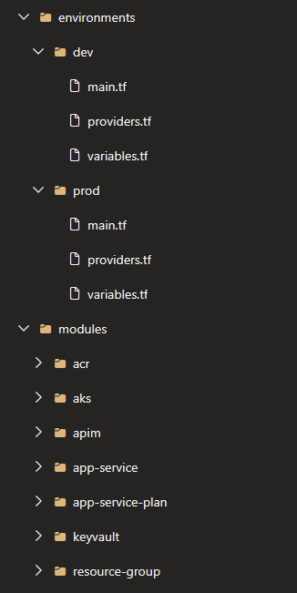
Environment directory
Creating a directory for each environment and organizing the infrastructure code within those directories

Slide 20
Terraform tfvars
To set lots of variables, it is more convenient to specify their values in a variable definitions file (with a filename ending in either .tfvars or .tfvars.json) and then specify that file on the command line with -var-file
Passar no nome da key (tfstate) via linha de comando
Notes:
https://developer.hashicorp.com/terraform/language/settings/backends/configuration
https://github.com/hashicorp/terraform/issues/13022
https://brendanthompson.com/posts/2021/10/dynamic-terraform-backend-configuration

Slide 21
Terraform Workspace
Refer to separate instances of state data inside the same Terraform working directory.
Terraform starts with a single, default workspace named default that you cannot delete.
A common use for multiple workspaces is to create a parallel, distinct copy of a set of infrastructure to test a set of changes before modifying production infrastructure.

Slide 22
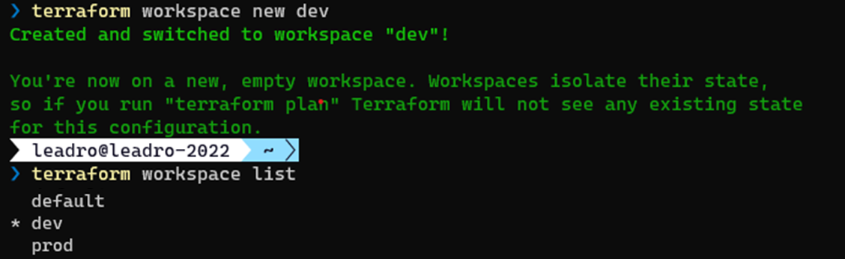
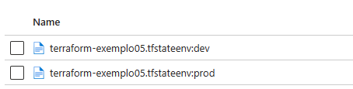
Terraform Workspace
For each workspace, a tfstate file is created
Notes:
https://developer.hashicorp.com/terraform/cli/workspaces

Slide 23
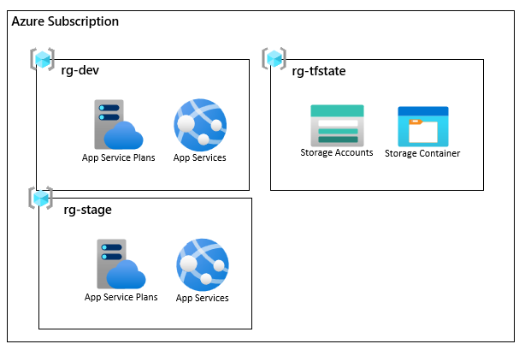
DEMO
Notes:
Folder: Demos/Exemplo06-Workspace
In this example, it should be explained how to work with Terraform Workspace.
Terraform Workspace is a feature that allows you to create isolated environments (DEV, HML, PRD) to test and manage your infrastructure.

Slide 24
Testing

Slide 25
Terraform Tests
Terraform tests let authors validate that module configuration updates do not introduce breaking changes.
Tests run against test-specific, short-lived resources, preventing any risk to your existing infrastructure or state.
This testing framework is available in Terraform v1.6.0 and later.

Slide 26
Integration or Unit testing
By default, tests within Terraform create real infrastructure and can run assertions and validations against that infrastructure. This is analogous to integration testing.
By default, each run block executes with command = apply instructing Terraform to execute a complete apply operation against your configuration. Replacing the command value with command = plan instructs Terraform to not create new infrastructure for this run block.

Slide 27
Syntax
Terraform discovers test files are based on their file extension: .tftest.hcl or .tftest.json.
Each test file contains the following root level attributes and blocks:
One to many run blocks.
Zero to one variables block.
Zero to many provider blocks.
Zero to many assertions blocks.

Slide 28
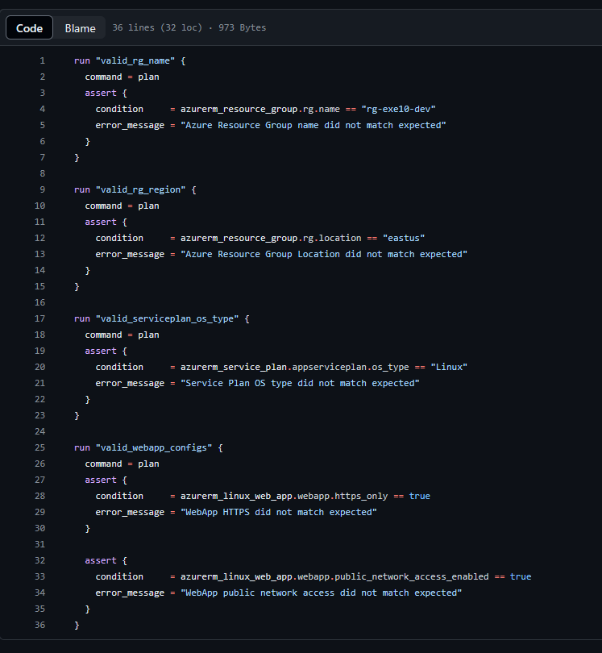
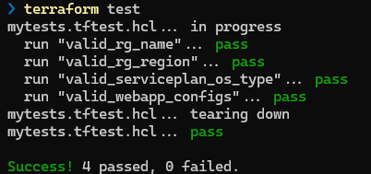
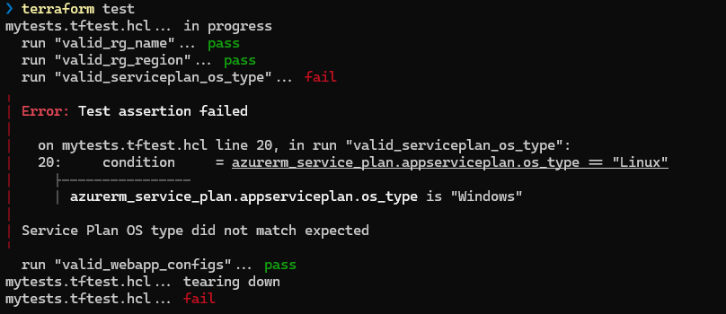
.tftest.hcl
Running

Slide 30
DEMO
Notes:
Folder: Demos/Exemplo10-Testing
In this example, we will see how to use Terraform to test the infrastructure.
Terraform has a feature called `terraform test` that allows you to test the infrastructure before applying it.

